Slide 1
Genome assembly and annotation Day 3: Genome assembly
MMB-114 Exploratory microbial research - lab course 2019
Igor Pessi
Department of Microbiology – UH
igor.pessi@helsinki.fi

Slide 2
Aims for this part of MMB-114
Day 1: Basics of UNIX and working with the command line
Day 2: Handling of Illumina data
Day 3: Genome assembly
Day 4: Check-up and report
Day 5: Genome annotation
Day 6: Metabolic pathway analysis
Get reads
Sequence quality trimming
Genome assembly
Genome annotation
Metabolic pathways

Slide 3
Additional notes about Taito
Batch jobs
https://research.csc.fi/taito-batch-jobs
sbatch
scancel
squeue
seff
Job ID: 41577920
Cluster: csc
User/Group: stelmach/project_2000577
State: COMPLETED (exit code 0)
Nodes: 1
Cores per node: 4
CPU Utilized: 01:15:20
CPU Efficiency: 74.29% of 01:41:24 core-walltime
Memory Utilized: 2.53 GB
Memory Efficiency: 25.92% of 9.77 GB
Job consumed 3.38 CSC billing units based on cpu reservation multiplier

Slide 4
We will start the day by launching the assembly jobs
https://github.com/igorspp/MMB-114
(Day 3: Genome assembly)
(Do only PART 1 for now)
Kmers list:
33: Rasmus and Emin
55: Helena and Zoe
77: Moritz and Sari
99: Paula and Victor
127: Colin and Minna

Slide 5
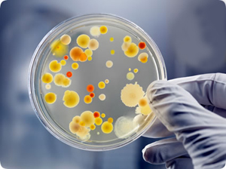
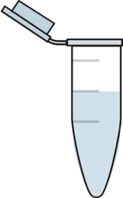
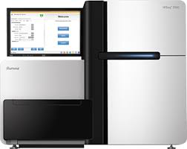
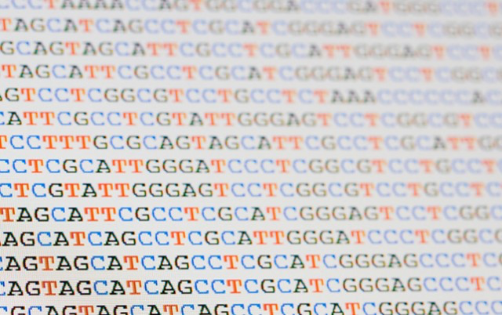
De novo genome assembly
In an ideal world:
DNA
Sequencer
Bacteria
Genome sequence

Slide 6

De novo genome assembly
Fragmentation
In reality…
DNA
Sequencer
Bacteria
Fragments of a genome

Slide 7
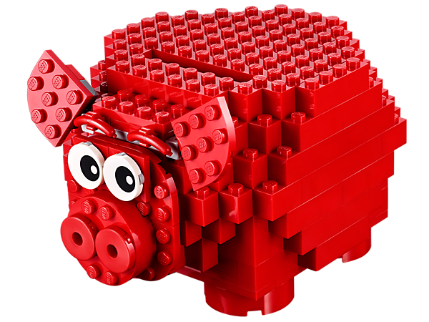
Genome assembly
Reconstruct the original genome from short sequence reads
In an ideal world: sequences = one complete genome
In reality: sequences = multiple contigs
Contiguous, unambiguous stretches of sequences

Slide 8
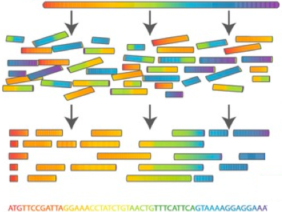
Genome assembly

Slide 9
Shakespearomics
Reads
ds, Romans, count
ns, countrymen, le
Friends, Rom
send me your ears;
crymen, lend me
Overlaps
Friends, Rom
ds, Romans, count
ns, countrymen, le
crymen, lend me
send me your ears;
Majority consensus
Friends, Romans, countrymen, lend me your ears;
A small genome
Friends,
Romans,
countrymen,
lend me your ears;

Slide 10
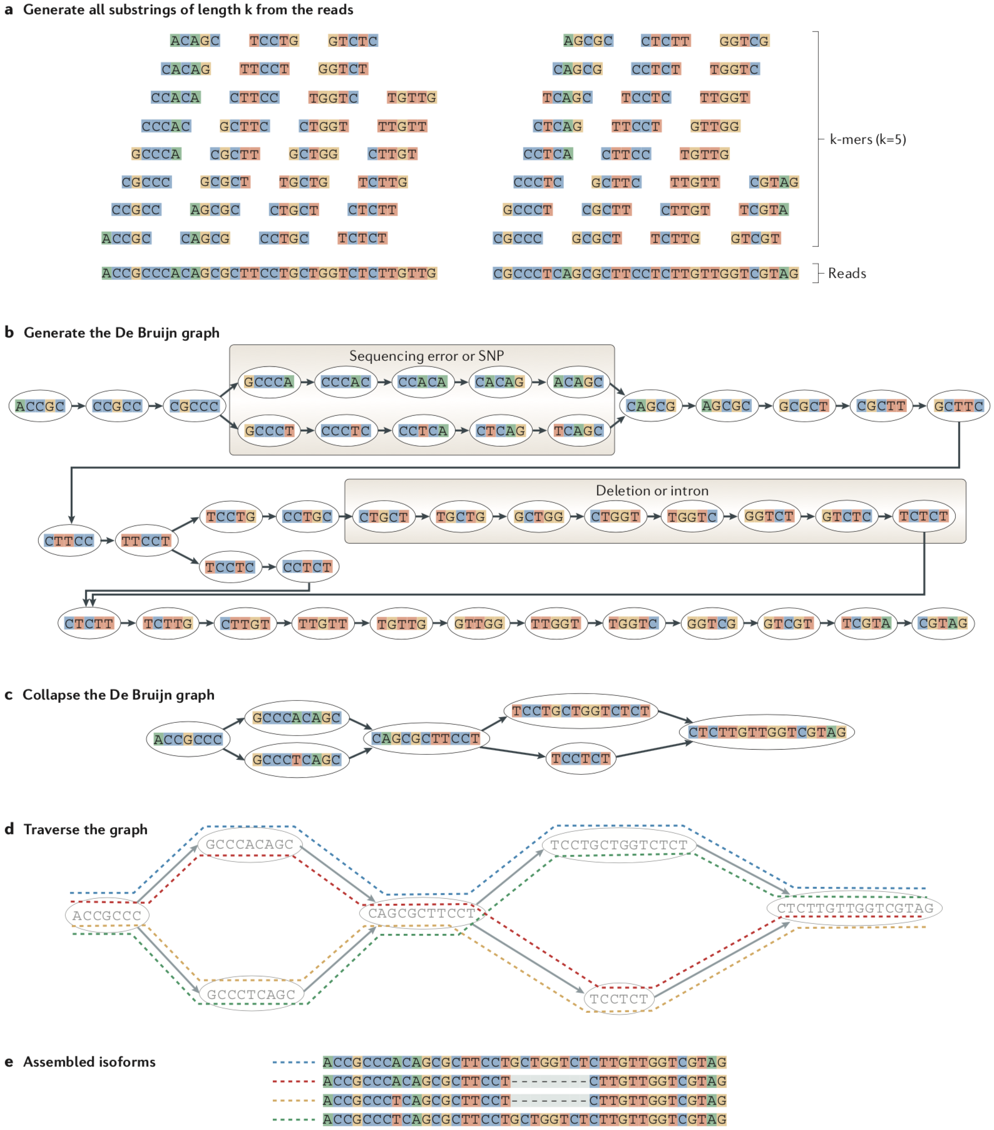
De Bruijn graph
In real life 10⁶ sequences cannot be compared with each other
10⁶ x 10⁶ = 10¹² comparisons
Sequences are reduced to k-mers
Smaller subsets of length k

Slide 11
Martin & Wang 2011
Nature Reviews Genetics
doi: 10.1038/nrg3068

Slide 12
Paired-end reads
5’ adapter
DNA fragment
3’ adapter
R1: 320 bb
R2: 280 bp

Slide 13
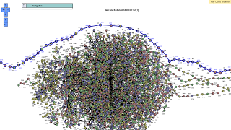
In real life with 10⁶ sequences

Slide 14
What makes assembly tricky?
Many pieces (computationally-intensive)
Errors in sequence (which one is correct?)
Missing fragments
Repetitive fragments
Multiple copies (rRNA gene as an example)
Circular genome (no starting point)
Choice of k-mer
Too small = misassembly (anything can assemble)
Too long = no assembly

Slide 15
Sequencing coverage
Coverage describes the number of time that each base of the genome is present in the reads
Assemblers work best at 60-100x coverage
Notes:
Fraction of the genome sequenced y at least one read

Slide 16
Estimated coverage for our strain
Lactobacillus genomes: ~2 Mb
Received data
725,942 pairs
326 + 278 bp
Coverage
Number of bases sequenced/genome size
Bases = (725,942 x 326 bp) + (725,942 x 278 bp)
236,657,092 bp + 201,811,876 bp = 438,468,968 bp
Coverage = 438,468,968 bp / 2,000,000 = 219.2

Slide 17
Assemblers
Bioinformatic tools that combine short sequencing reads into longer contigs
For our Lactobacillus genome, we will test two assemblers:
Manual: VELVET
https://www.ebi.ac.uk/~zerbino/velvet/
Automated: SPADES
http://bioinf.spbau.ru/spades

Slide 18
Batch scripts
#!/bin/bash -l
#SBATCH --job-name spades
#SBATCH --output spades_out_%j.txt
#SBATCH --error spades_err_%j.txt
#SBATCH --time 2:00:00
#SBATCH --nodes 1
#SBATCH --ntasks-per-node 1
#SBATCH --cpus-per-task 4
#SBATCH --mem 5000
module load biokit
spades.py -1 TRIMMED/R1_q20_m60.fastq \
-2 TRIMMED/R2_q20_m60.fastq \
-o SPADES \
-t 4
#!/bin/bash -l
#SBATCH --job-name velvet
#SBATCH --output velvet_out_%j.txt
#SBATCH --error velvet_err_%j.txt
#SBATCH --time 2:00:00
#SBATCH --nodes 1
#SBATCH --ntasks-per-node 1
#SBATCH --cpus-per-task 1
#SBATCH --mem 8000
module load biokit
velveth VELVET_33 \
33 \
-shortPaired \
-fastq \ -separate \
TRIMMED/R1_q20_m60.fastq \
TRIMMED/R2_q20_m60.fastq
velvetg VELVET_33 \
-exp_cov 220 \
-ins_length 300 \
-scaffolding no

Slide 19
Assembly quality
What is a good assembly?
Good coverage throughout the contigs
Correct size (for bacteria, not 400 k or 14 Mb)
As fewer contigs as possible
Similar GC across contigs
N50 value

Slide 20
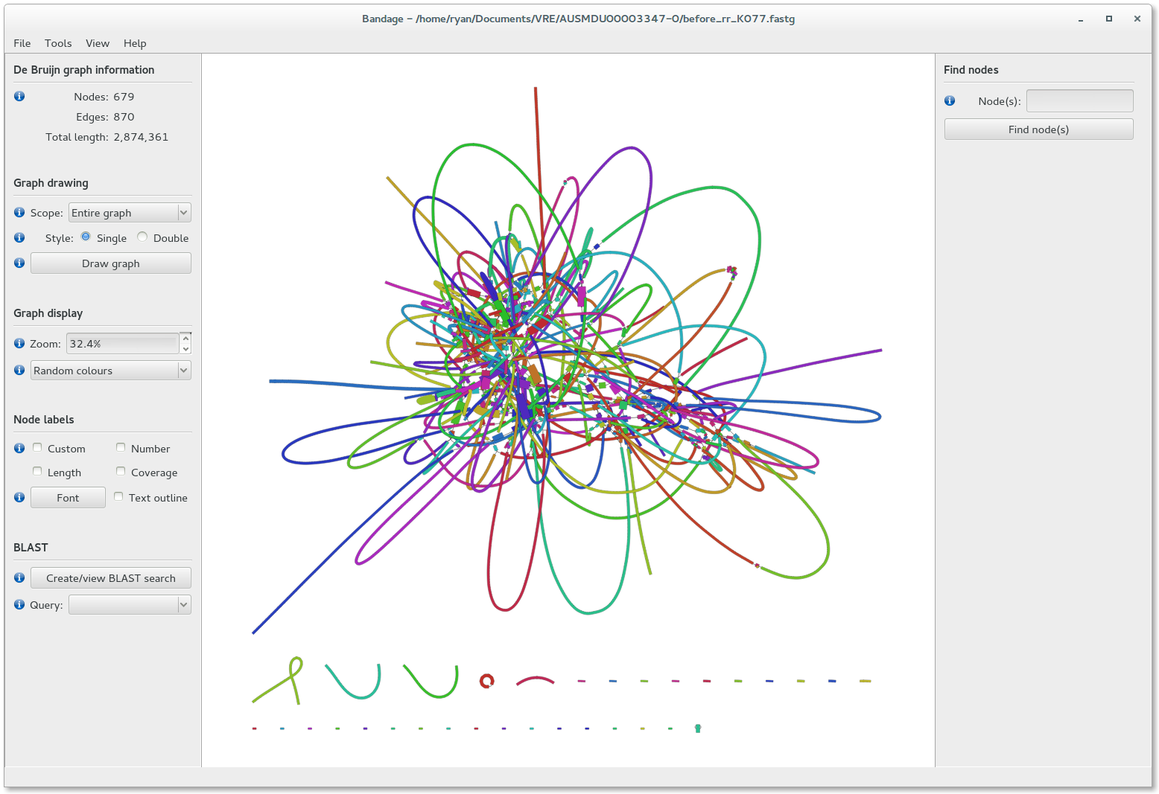
SPADES output
contigs.fasta: this contains the contigs generated by SPADES
scaffolds.fasta: contigs generated by SPADES after repeat resolution and scaffolding using paired-end information
assembly_graph.fastg: the assembly graph generated by SPADES

Slide 21
QUAST
http://bioinf.spbau.ru/quast
Tool to evaluate the quality of assemblies
After running QUAST, move to your computer with FileZilla:
report.html
report.pdf
icarus.html
icarus_viewers (folder)

Slide 22
Let’s run QUAST
https://github.com/igorspp/MMB-114
(Day 3: Genome assembly)
(Do PART 2 now)

Slide 23
How do assemblies look like?
More contigs?
Longer assembly?
Better N50?
Longer contigs?
Which one would you choose?

Slide 24
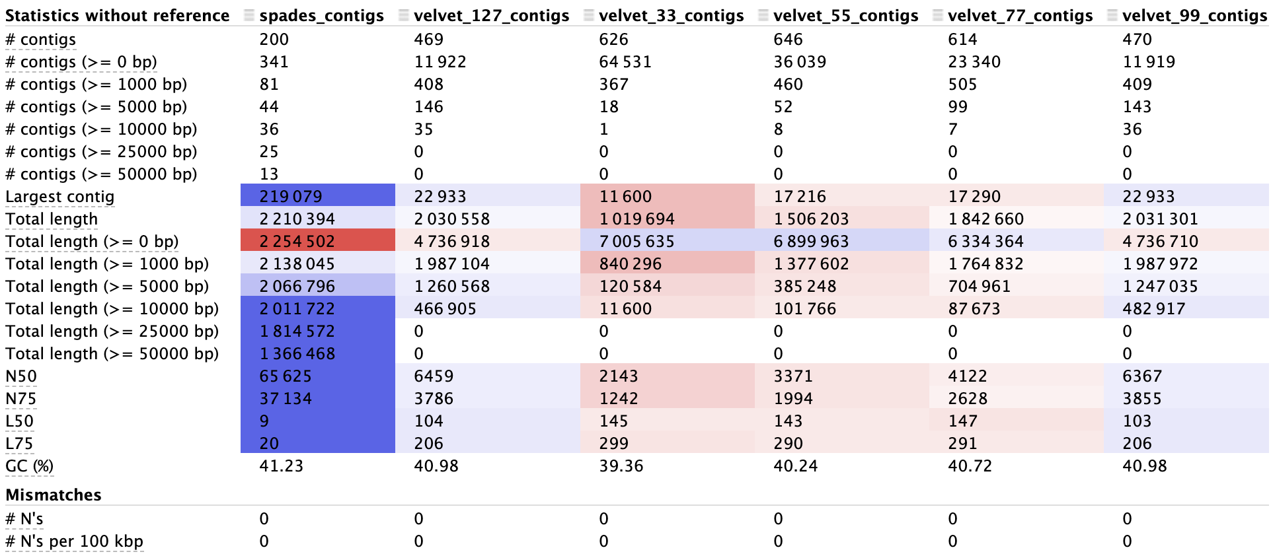
How do assemblies look like?

